Slide 1

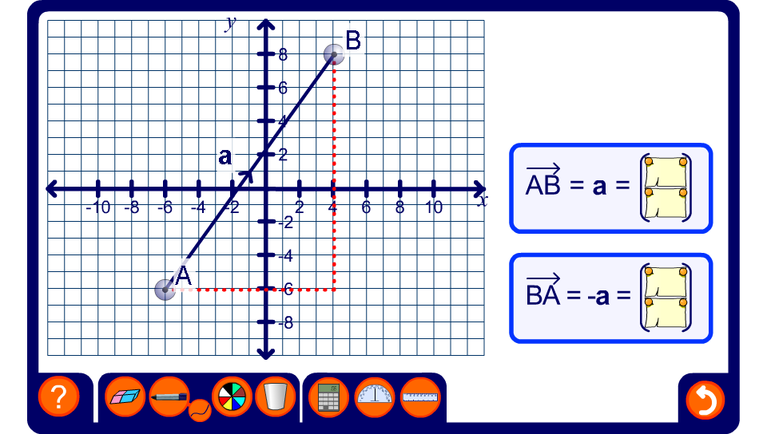


The negative of a vector
Notes:
Use this activity to demonstrate negative vectors.

